Slide 1
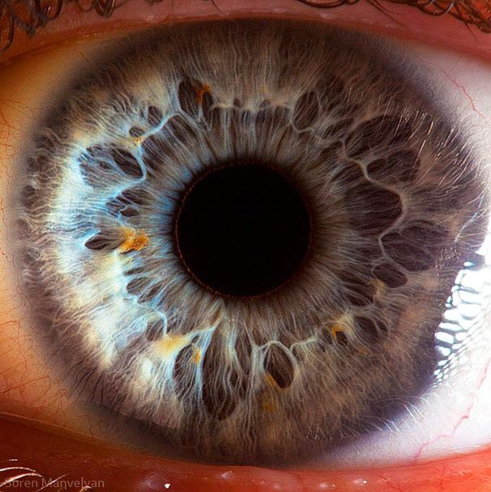
Art Analysis: Ways of “Seeing”
Mr. Josh Ney
Visual Art
Grades 9 – 12
March 7, 2012

Slide 2
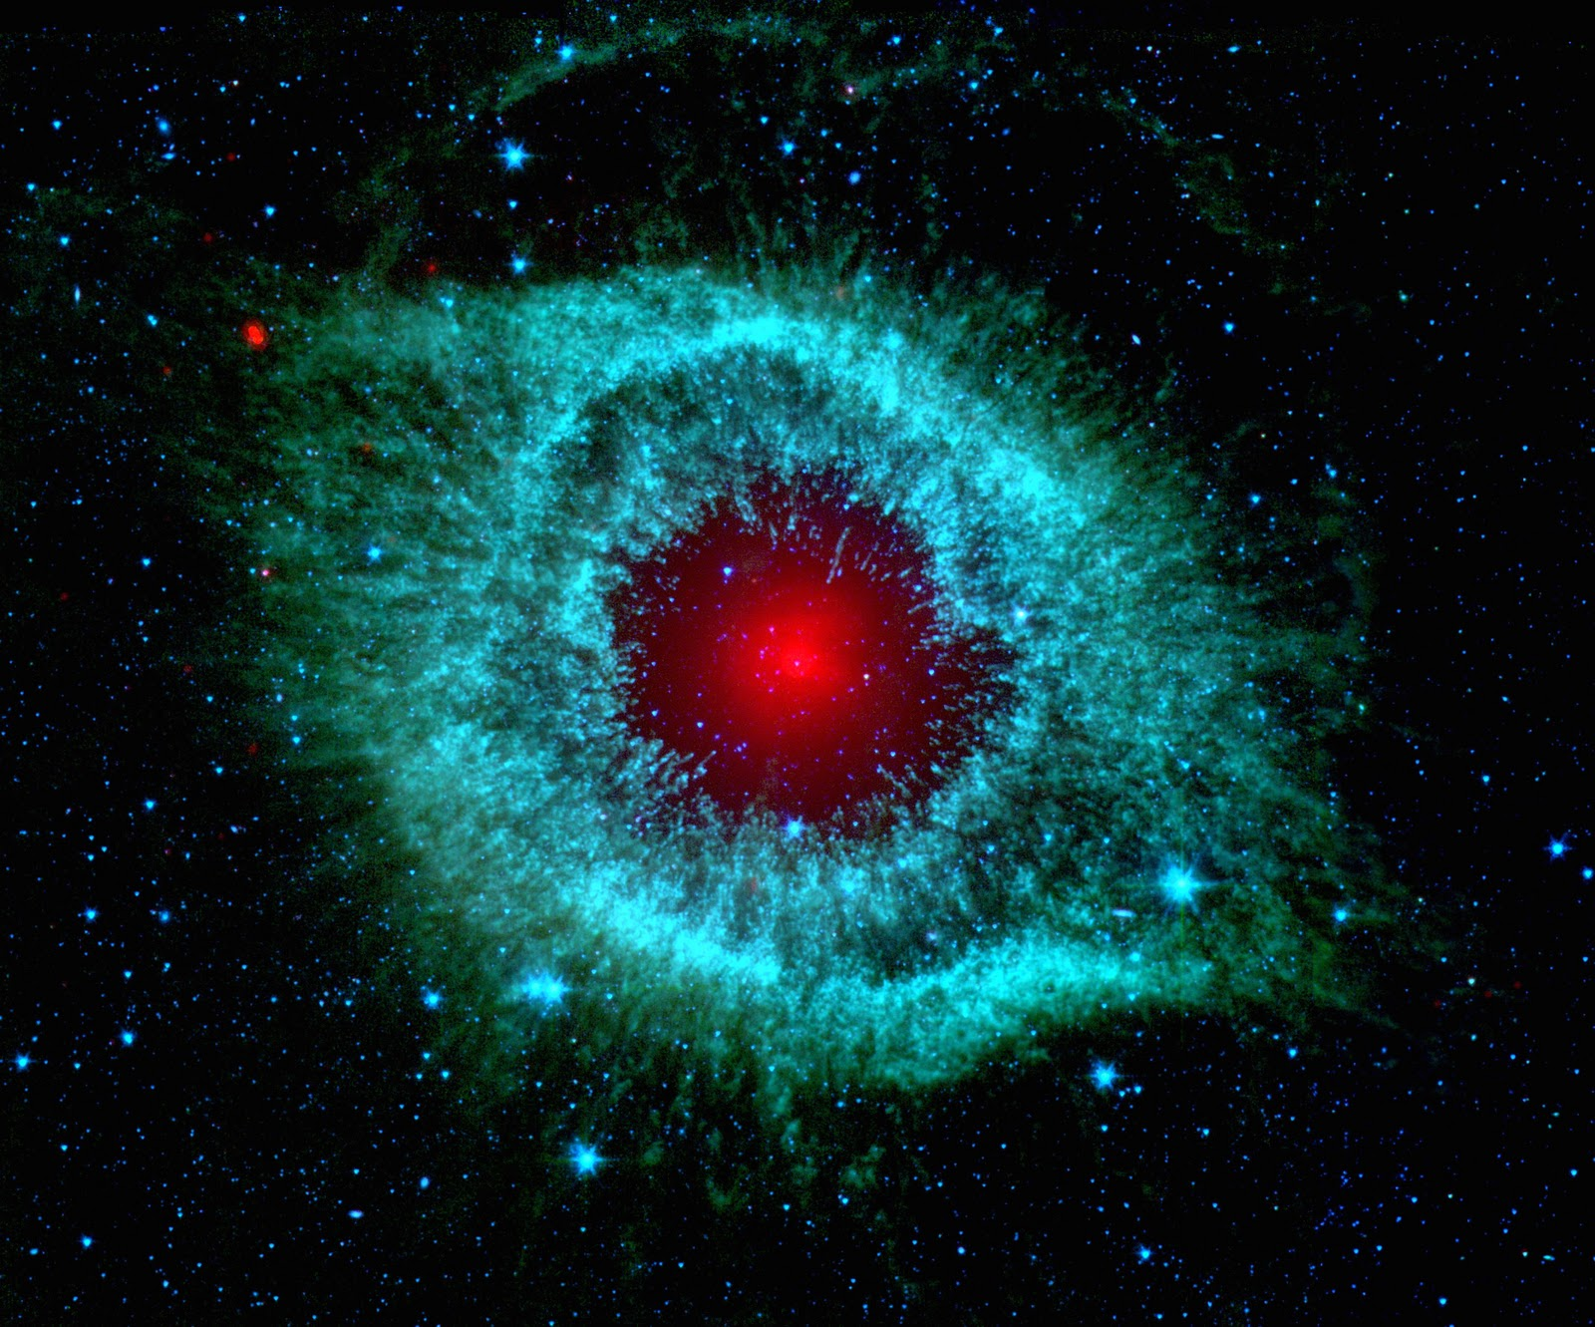
Review: 7 Elements of Art
1. Texture – the quality of surface of art or the way any piece of art
is represented.
2. Space – area provided for a specific purpose.
3. Shape – pertains to the use of two-dimensional space; defined by all other elements.
4. Line – the path of a moving point.
5. Form – a three dimensional shape that show depth, height, and width.
6. Color – pertains to the use of hue defined by primary and secondary colors.
7. Value – the use of light and dark within a piece of art.

Slide 3
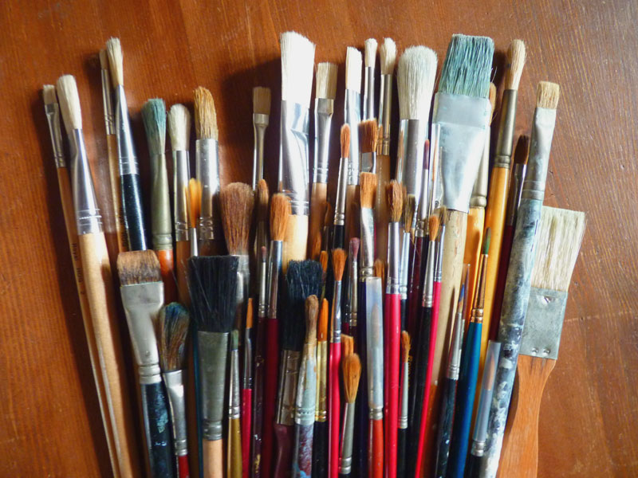
Review: Visual Art Mediums
Drawing – pencil, charcoal, graphite, marker, chalk, pastel, watercolour
Painting – oil, acrylic, watercolor, ink, vinyl
Bases for drawing and painting – paper, wood, canvas, cloth, metal.
Photography – digital image sensor, photographic film, potassium dichromate, potassium ferricyanide, ferric ammonium citrate, and silver nitrate.

Slide 4
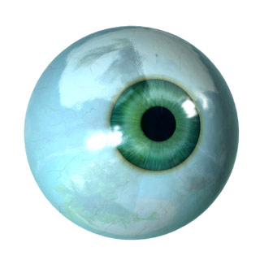
How it all works: the science of the human visual system
First, a source of light is required in an individual’s external environment.
This light, given from the sun or other sources, emits particles called photons.
The light bounces off of objects within our environment before it reaches a person’s eyes.
Once at the eyes the photons pass through the cornea, the lens, the vitreous humour, until the retina is reached.
At the retina the photons stop at the retinal pigment epithelium where nerve pulses are set off.
Nerve pulses are then directed to the optic nerve to move along the optic pathways.
The pulses follow the pathway to the visual cortex of the occipital lobe where the external image is formed.
Video: Looking at how we see

Slide 5
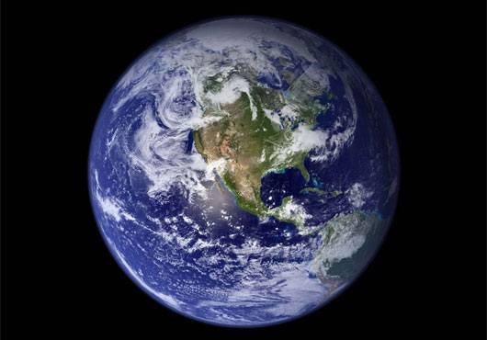
Art and Artists
Art and creativity are not just found in art galleries.
The institution of art is a means of expressing creativity as human beings.
Everything from music, film, billboards, books, and photographs are all popular ways of expressing creativity.
But even creativity itself is not confined to these borders of culture and society.
A person does not have to paint, draw, take pictures, or create music to be an artist.
The need for creativity and human expression are inherent drives within all human beings.

Slide 6
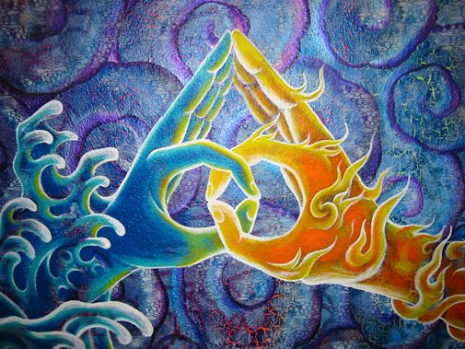
The Relationship: Artist, Art, and Viewer
One of the fundamental reasons artists create art is to send a message to the viewer.
When an artist creates they are saying a lot about their perspective and worldview.
The message can be very literal and concrete or its meaning can be abstract and conceptual.
Viewers are left to engage and experience art through the different levels of “seeing”.

Slide 7
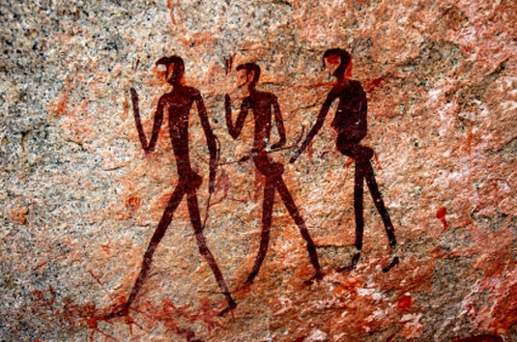
“Seeing” Through the Senses
Artist:
Many contemporary artists and their works of art begin and end within this basic physical realm.
The frame of mind which the artist is workign can be summed up with a “what you see, is what you get” perspective.
Viewer:
The most primitive way of “seeing” a piece of art is with the eyes of the flesh.
The eyes of flesh perceive art in terms of the physical objects within a painting .
Art can be created on higher levels of human perception, but the viewer may not be able to recognize the higher levels if they only perceive the physical objects.

Slide 8
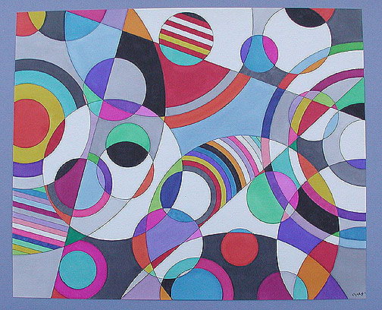

Slide 9
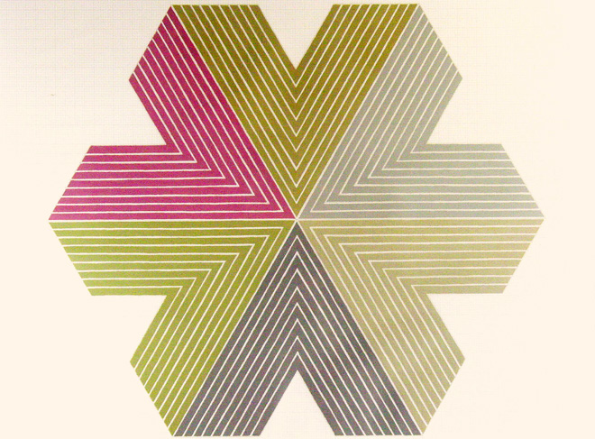

Slide 10
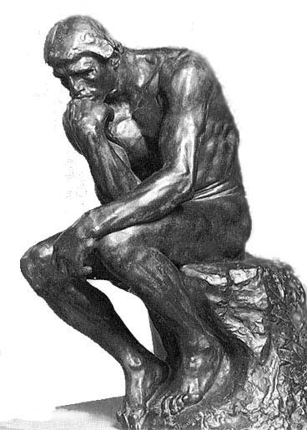
“Seeing” Through the Mind
Artist:
In this realm the artist portrays thoughts, concepts, and ideas within the painting.
This way of “seeing” typically transcends and includes the stage of the senses
At this stage artists are able to engage the viewer with higher levels of thinking and effectively communicate philosophies, perspectives, and worldviews.
Viewer:
In this realm the viewer is able to see with more than just the physical eyes.
The viewer does more than look at the material components of the piece of art.
The viewer is now “seeing” with their mind.
At this stage viewer’s analyze a piece of art and contemplate different symbols and messages within the artwork, to attempt to take the perspective of the artist and come to a logical synopsis of the piece as a whole.

Slide 11
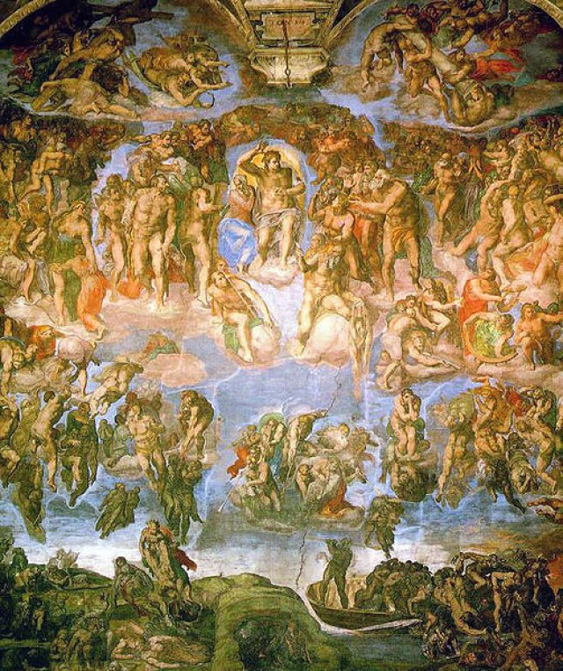

Slide 12
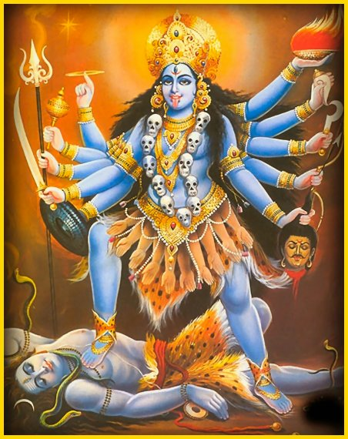

Slide 13
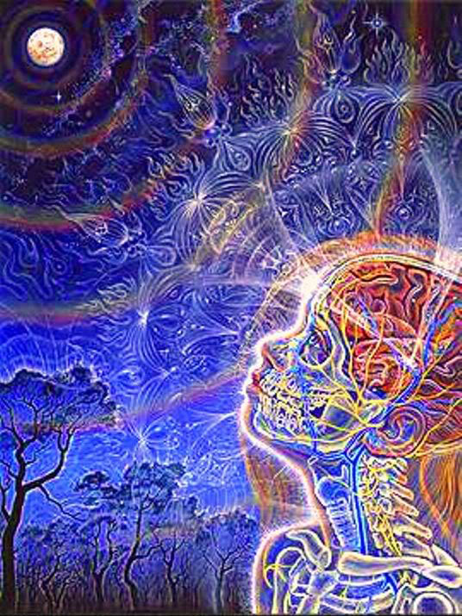
“Seeing” through the Soul/Spirit
Artist:
In this realm the artist creates artwork that engages all of the human faculties.
Artists can include aspects of the senses and of the mind; as well as, a variety of other aspects.
Viewer:
When art is “seen” through the soul/spirit the viewer is engaged in a uniquely personal experience with the piece of art.
The viewer interacts with the painting to the point where a person is able to come to greater depths of understanding and awareness than they would seeing through the eyes of the flesh and eyes of the mind.

Slide 14
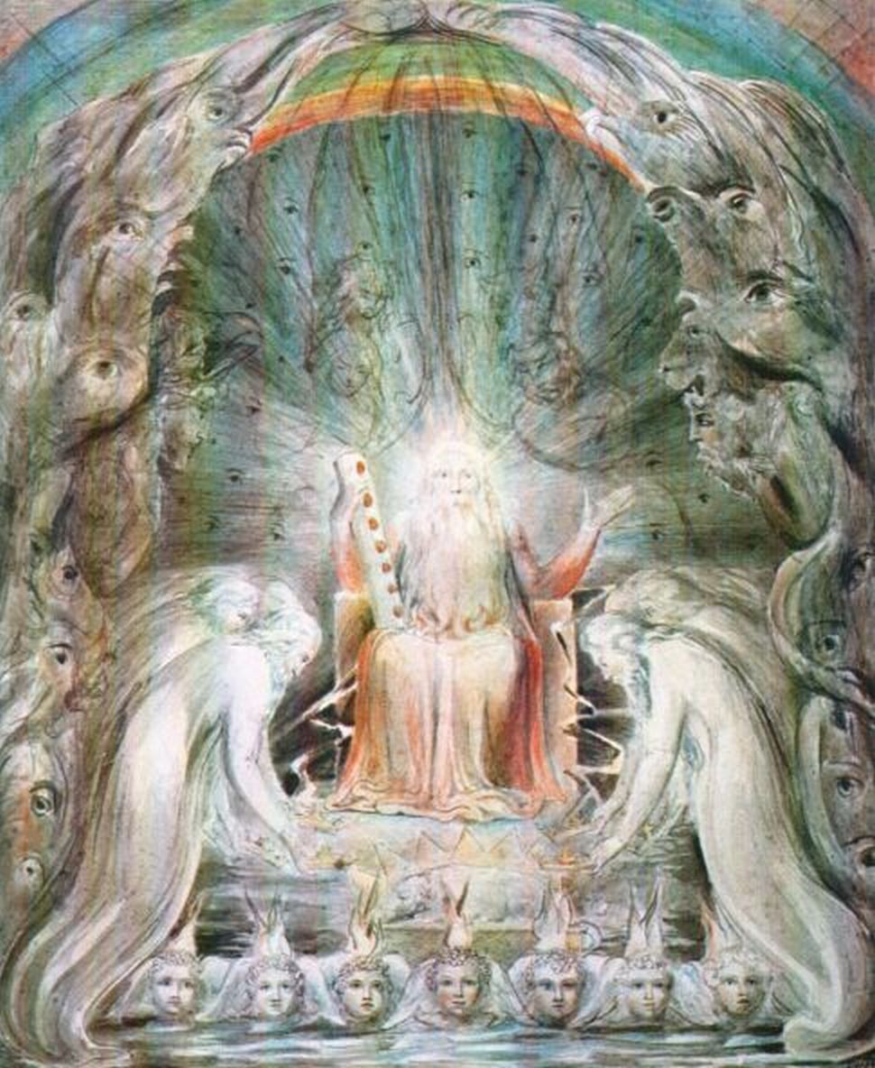

Slide 15
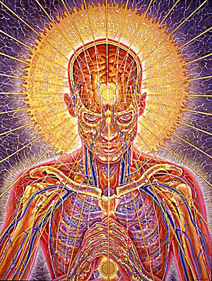

Slide 16
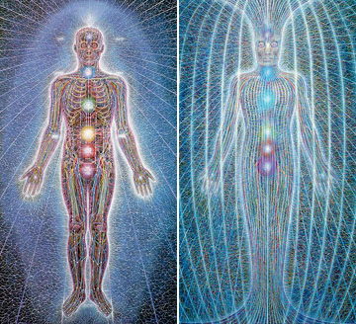

Slide 17
References
Page 6: Luke Brown – Hands
Page 7: Unknown – Cave Painting
Page 8: Bruce Gray – Eye Candy #2
Page 9: Frank Stella – Snow Flake
Page 10: Michelangelo – The Thinker
Page 11: Michelangelo – The Last Judgment
Page 12: Unknown – Kali
Page 13: Alex Grey – Wonder
Page 14: William Blake: Seven Spirits of God
Page 15: Alex Grey: Praying
Page 16: Alex Grey: Psychic Energy System and Spiritual Energy System
Grey, Alex. ( 2001 ). The Mission of Art. Boston, MA: Shambhala.

